Slide 1
Mobile Databases
Class
    Will
        Start
        Momentarily…

Slide 2
Overview
I) Mobile Databases: Intro, Motivation
II) PDA: Palm versus Pocket
III) Synchronization
IV) Mobile DB Alternatives
V) Sybase
VI) Oracle
VII) Microsoft
VIII) Point base
IX) Selecting a Mobile DB

Slide 3
Mobile Databases: Intro
Functionality required of mobile DBMSs includes ability to:
  communicate with centralized database server through modes such as wireless or Internet access;
  replicate data on centralized database server and mobile device;
  synchronize data on centralized database server and mobile device;
  capture data from various sources such as Internet;
  manage/analyze data on the mobile device;
  create customized mobile applications.

Slide 4
Mobile Databases : Why ?
Smart client applications have emerged as the architecture of choice over browser-based wireless Internet applications, as they enable access to data while the mobile user is disconnected from the network—wireless or otherwise. This capability is best implemented by incorporating persistent data storage using a mobile database in your application.

Slide 5
Off-Line Access versus On-Line Wireless
The main advantage of using a mobile database in your application is offline access to data—in other words, the ability to read and update data without a network connection. This helps avoid problems such as dropped connections, low bandwidth, and high latency that are typical on wireless networks today.
http://www.devx.com/wireless/Article/11398/1411/pdo/6756F68B3FCA9F80290D98E118909A0D:3835/page/1

Slide 6
PDA: PALM or Pocket ?
PALM (PALM OS)
Most popular PDA (earlier, 1992)
> 13,000 soft. applications
Focused on calendar, scheduling.
Popular to Linux User
http://reviews.zdnet.co.uk/review/12/1/1391.html
POCKET PC (Windows / CE)
Microsoft Backed
Growing rapidly
Integrates MS-Windows applications
Focus was more broad (datawarehouse, etc.)
Popular to MS-Windows User
http://www.cewindows.net/wce/21/palmvswindowsce.htm

Slide 7
PDA: Palm or Pocket ?
Color,
Sound (MP3),
Superior for Games
Multitasking
Better Web Browser and Wireless Connectivity
the way the Pocket PC interacts, connects and seamlessly integrates within Microsoft-based servers and applications within IT environments
Microsoft partnership with hardware manufactures
http://www.zdnet.com.au/newstech/communications/story/0,2000048620,20107806-1,00.htm

Slide 8
PDA: Palm or Pocket ?
Round 1: Ease of use PALM
Round 2: Entering data Pocket
Round 3: Core applications Even
Round 4: Desktop compatibility PALM
Round 5: Email PALM
Round 6: Office compatibility Even
Round 7: Multimedia Pocket
Round 8: Available software PALM
http://www.zdnet.com.au/reviews/coolgear/pdas/0,39023392,39116317,00.htm

Slide 9
Synchronization Questions
Will it be two ways (download & upload) ?
What happens if records have been added in both the consolidated database and the PDA since last synchronization ?
What happens if records have been modified in both the consolidated database and PDA since last synchronization ?
What happens if records have been deleted in one of the databases ?
What is the default action that my software performs ?
What can I do with the scripts ?
What type of transactional control exists in the synchronization ?
Will there be more than one PDA synchronizing with the Server at the same time ?

Slide 10
Replication versus Synchronizing
"Replication" is about copying data. Typically one way process
Synchronization is typically a two-way process, however, where changes in the master copy are reflected in the local copy, and vice-versa.
Synchronization may involve data transformation.

Slide 11
Hotsync (Palm) or ActiveSync (Pocket)
Program that comes free with PDA purchase. Run on the host (workstation, laptop) computer to permit it to exchange information with the PDA.
1) Connectivity for program installation
2) File browsing on PDA device
3) Backup/Restore
4) Network connectivity for docked PDA device
5) Data/File Synchronization (Synchronizes your e-mail, agenda, contacts, and other desktop programs).

Slide 12
Mobile DB Environments
Database Front-End
C, C++
Java
Visual Studios (C++, VB, C#, J#)
Appforge – Mobile VB
Database Backend
Sybase’s Ultralite
Oracle Lite
MS-Pocket Access
MS-SQL Server CE
Pointbase

Slide 13
Sybase
Market Leader (over 60% of mobile market)
Mobilink (Synchronization Server) and Ultralite (Mobile Database)
Can synchronize Data to Databases of different Vendors (not tied to Sybase’s Enterprise Edition).
Ultralite comes with Appforge’s Mobile VB

Slide 14
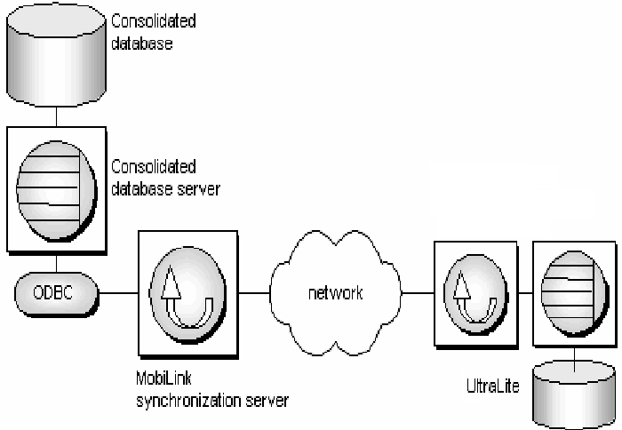
Sybase’s Mobile Architecture

Slide 15
Sybase - Ultralite Process
SQL Statements → Reference Database ← Database Schema
|
|
| Application
| (source)
| |
V V
Ultralite Generator → Ultralite DB → Compiler
(source) |
V
Application
for PDA
Note: Ultralite is not a trimmed down relational database engine.

Slide 16
Advantages of Ultralite Process
Developers don’t have to learn 2 different DB
Only Included in Database Engine what is needed
Has power of the Server
Faster. Access Plans are already compiled
Obs.: Application can’t modify DDL (most
applications don’t need to).
.usm: ultralite schema (created with ultralite schema painter) or other utility.
.udb: ultralite database (created by application program based on .usm)
For Ultralite User’s guide, click here

Slide 17
Oracle Lite – Basics
Very Powerful
supports 100% Java development (through JDBC drivers and the database's native support for embedded SQLJ and Java stored procedures)
Supports programming from any development tool that supports ODBC (Visual Basic, C++, Delphi, and so on).
WindowsCE (Pocket) and PalmOS (Palm).
Includes Mobile SQL that is the mobile equivalent of Oracle's SQL*Plus tool.
Only Oracle DBMS significantly different.

Slide 18
Oracle Lite – Some Differences between other Oracle Products
Max. Database Size | 4GB
Client support | Palm & Pocket PC
Hardware requirements | 1MB Ram, 5MB Disk
Indexing | Only B+ trees
File Structure | 1 DB File

Slide 19
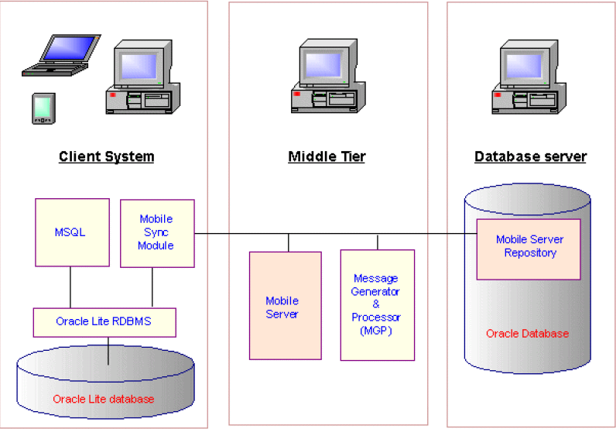
Oracle Lite Architecture

Slide 20
Oracle Lite – Sync
the Mobile Server product manages the synchronization of data to and from the mobile device (similar to Sybase’s Mobilink).
Unlike the Sybase, Oracle9i Lite assumes the use of Oracle databases on the Server.
Extremely Large Footprint (especially when using Web-to-go or Wireless Bandwith).

Slide 21
Web-To-Go
a component of Oracle9i Lite (wizard), consists of a collection of modules and services that facilitate development, deployment, and management of mobile Web applications.
Allows Oracle Lite users to perform replication, synchronization, and other networking issues without coding.

Slide 22
Not Supported in Oracle Lite
PL/SQL (use Java Stored Procedures and triggers instead)
Oracle Light is intended as a small, single-user client database and do not support any server functionalities like Java CORBA ORB's, SQL*Net Listeners, etc.
Only a few selected dictionary views are available, ALL_TABLES, ALL_VIEWS, ALL_USERS, CAT, etc.
An Oracle Lite database can only be queried from a remote client if it's data is replicated.

Slide 23
Tutorials for Oracle Lite
http://www.oracle.com/technology/tech/wireless/tutorials/lite_windowscetutorial11-02.pdf
http://www.oracle.com/technology/products/lite/tutorials/index.html

Slide 24
Microsoft’s Mobile Databases
Pocket Access 2002
ADOCE database access classes.
for smaller database applications that need to operate on a small number of tables.
Pocket Access files are stored using the .cdb extension and are populated by one or more tables from a desktop Access database.
Replication/Synchronization is very simple, through ActiveSync
SQL Server 2000 Windows CE (SQL Server CE).
ADOCE database access classes or OLE DB/CE
replication with an enterprise SQL Server data store as well as advanced database capabilities.
Synchronized through RDA or Merge Replication (both through IIS)

Slide 25
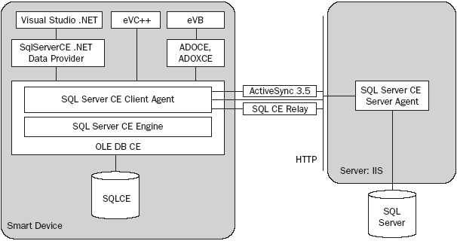
SQL Server CE

Slide 26
Pointbase
Like Oracle Lite, it is Java Based.
wide variety of platforms (more than Oracle Lite).
Its founder: Bruce Scott, cofounder of Oracle (with Larry Ellison).

Slide 27
Choosing a Mobile DB
MS-Access Server ? -> Pocket Access
MS-SQL/Server ? -> MS-SQL/CE
Oracle Server ? -> Oracle Lite
Multiple Platforms -> Sybase
Multiple Platform, Java Development -> Pointbase
Oracle Lite: most powerful
Sybase’s Ultralite: small footprint, very flexible
XML, C & C++ ?

Slide 28
End of Lecture
End
Of
Today’s
Lecture.

